Slide 1

Unit 8

Slide 2
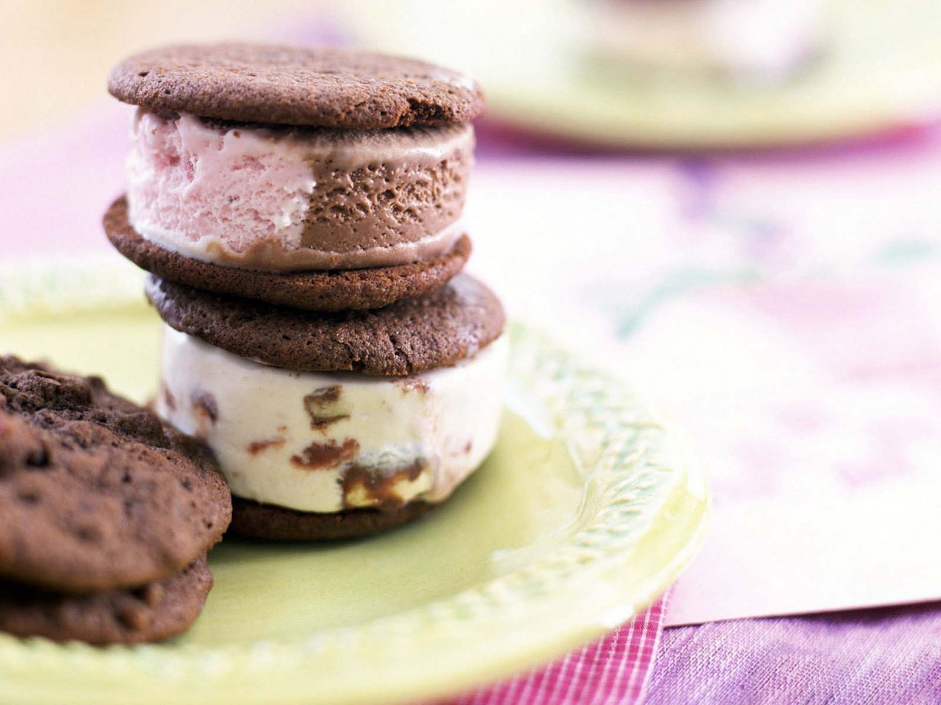
Opener

Slide 3
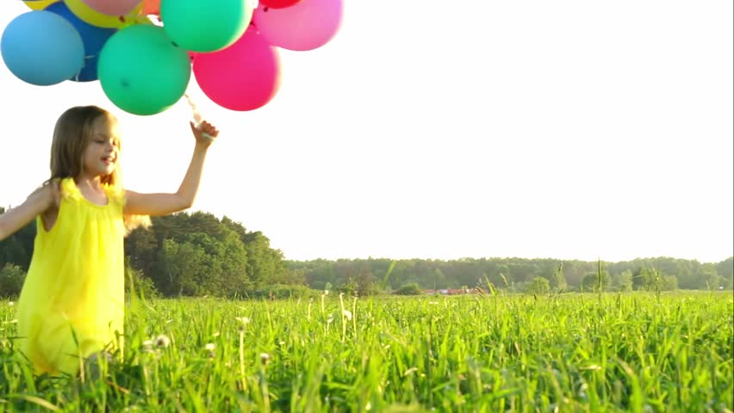

Write words which begin with the letter

Slide 4



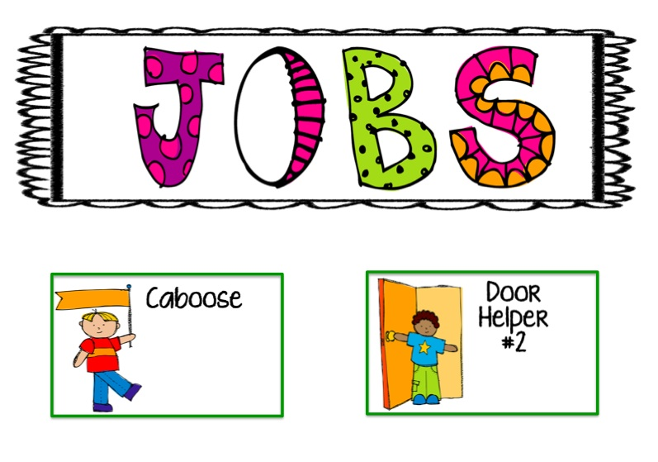


thing

Slide 5
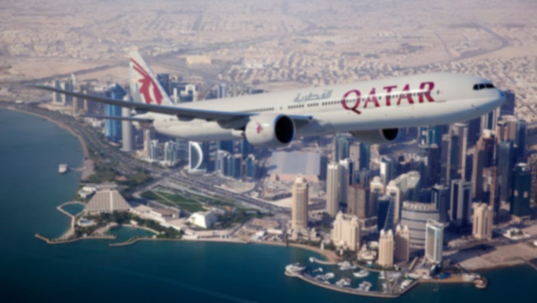

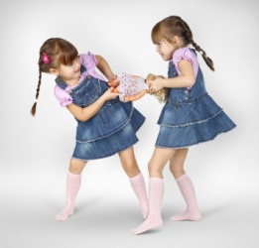
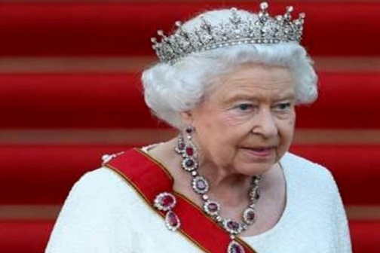
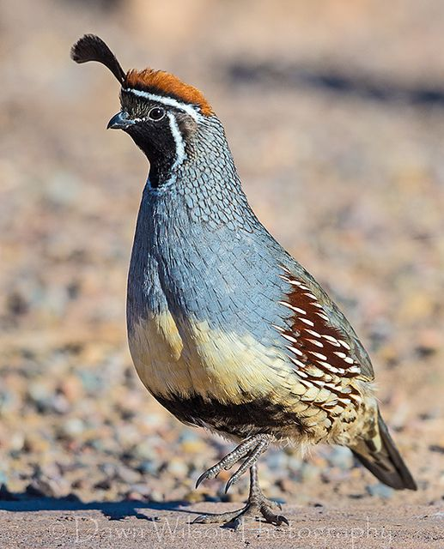
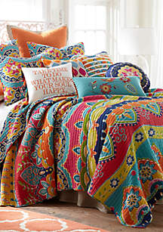
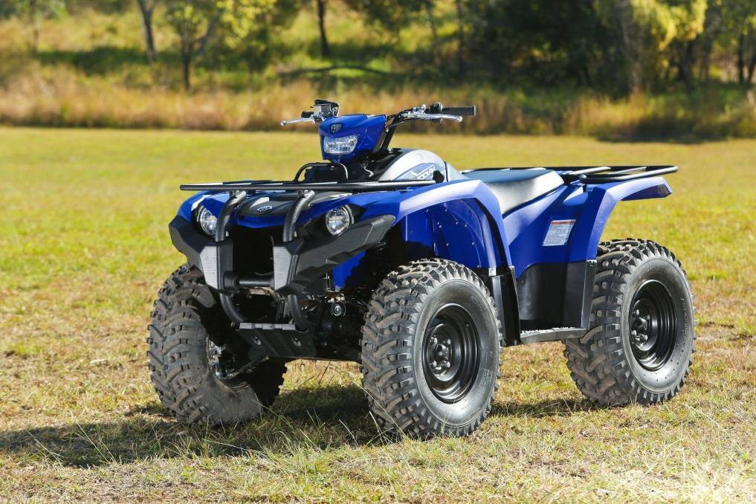

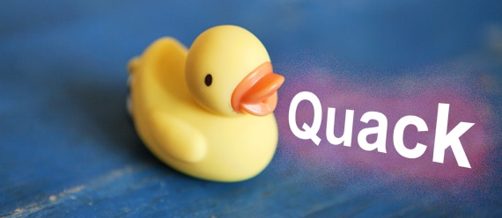
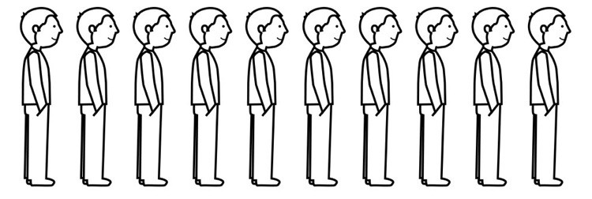

thing
quarrel
queen
quail
quilt
Qatar
quad bike
queue
quill

Slide 6
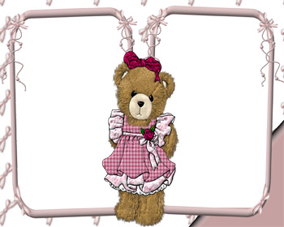
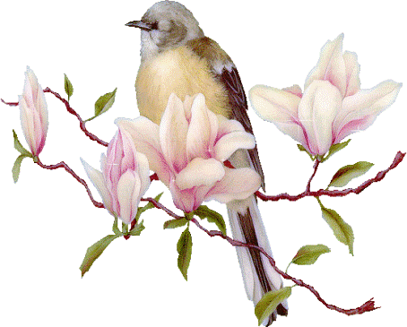

Grammar
Do your best

Slide 7
Do as shown between brackets:
We will book three tickets this evening.
ask a question
Telegraphs are used nowadays.
make negative

Slide 8
We will book three tickets this evening.
ask a question
How many tickets will you book this evening?
When will you book tickets?
What will you do this evening?

Slide 9


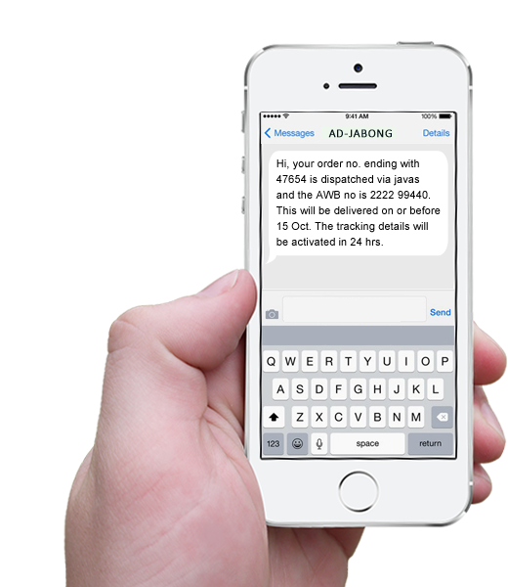
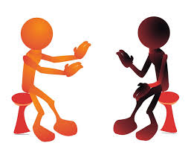
Mention means of communication.

Slide 10
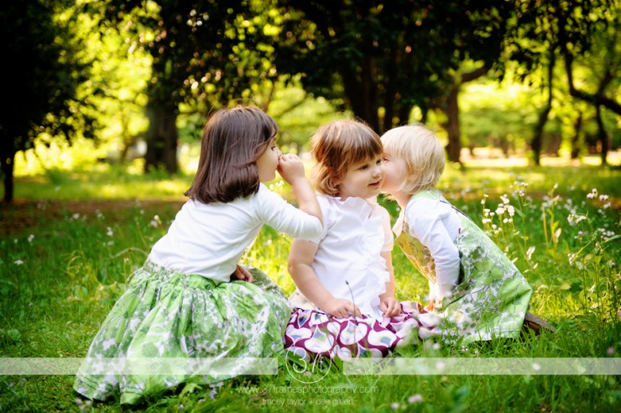
Let’s study some adjectives, shall we?

Slide 11
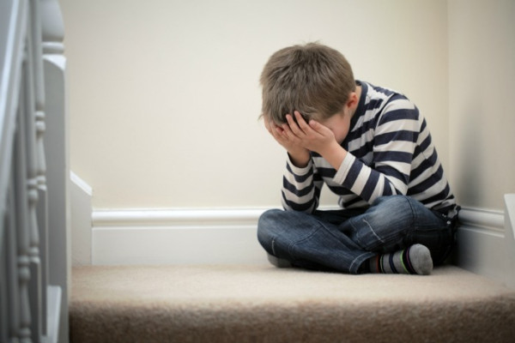
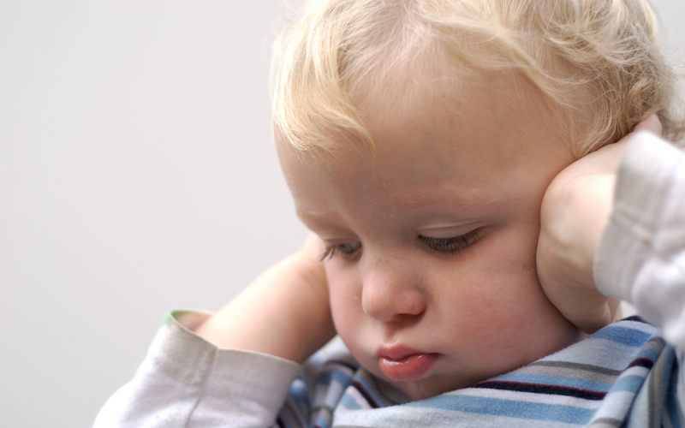
We have to be very careful with what we say to sensitive people.

Slide 12
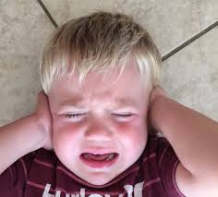
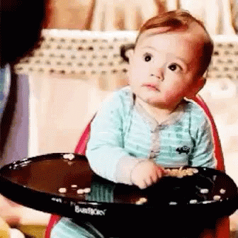
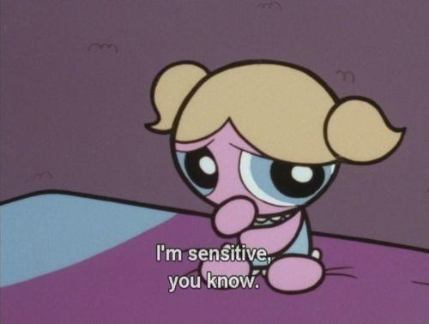

sensitive
easily upset by the things people say or do, or causing people to be upset, embarrassed, or angry

Slide 13
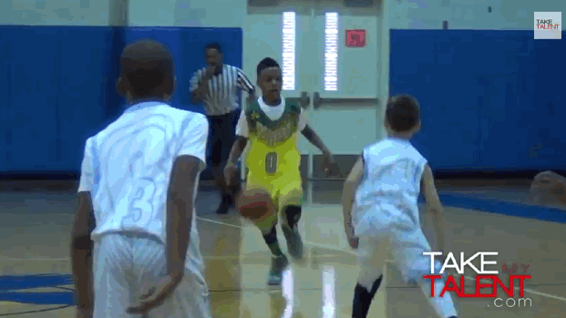
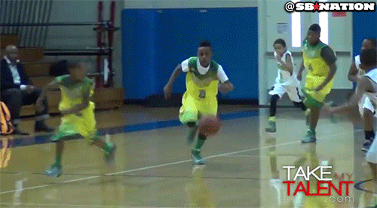
The boys are very talented. Playing basketball is their talent.

Slide 14
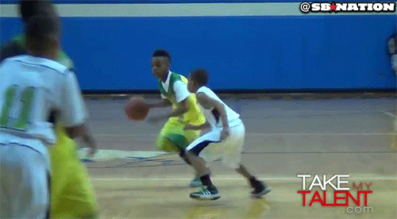
talented
with talent

Slide 15
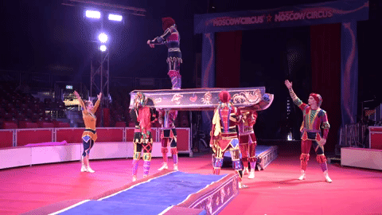
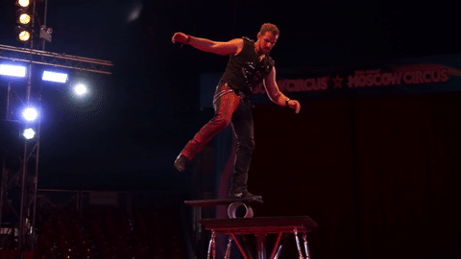
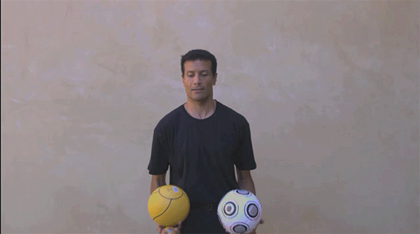
People who work in the circus are so skillful.

Slide 16
skillful
good at doing something, especially because you have practised doing it

Slide 17
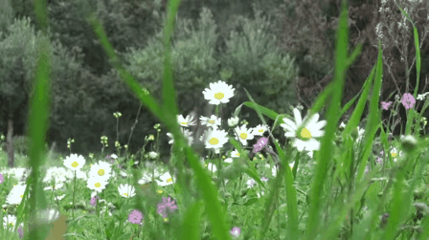
New Vocabulary

Slide 18
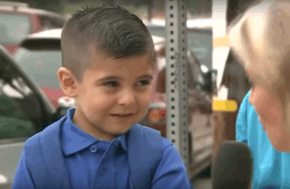
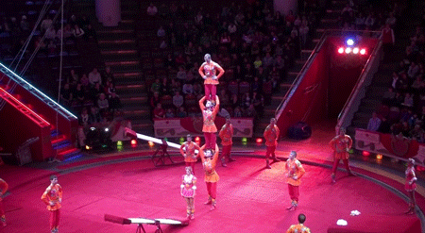
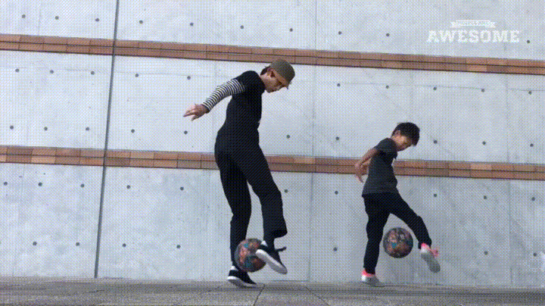
sensitive (adj.)
talented (adj.)
skillful (adj.)

Slide 19
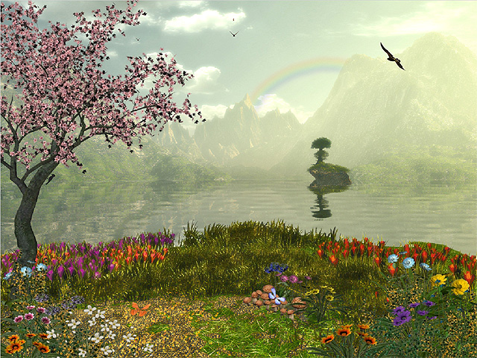
Student’s Book
Page 66

Slide 21
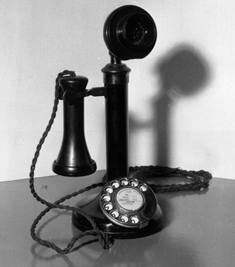
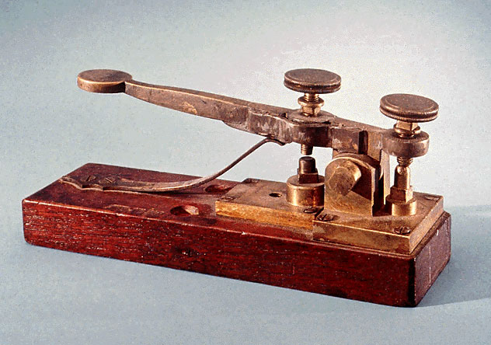
Examples:
• The telephone was invented in the 19th century. The telegraph was invented in the 19th century.
• Both the telephone and the telegraph were invented in the 19th century.

Slide 22
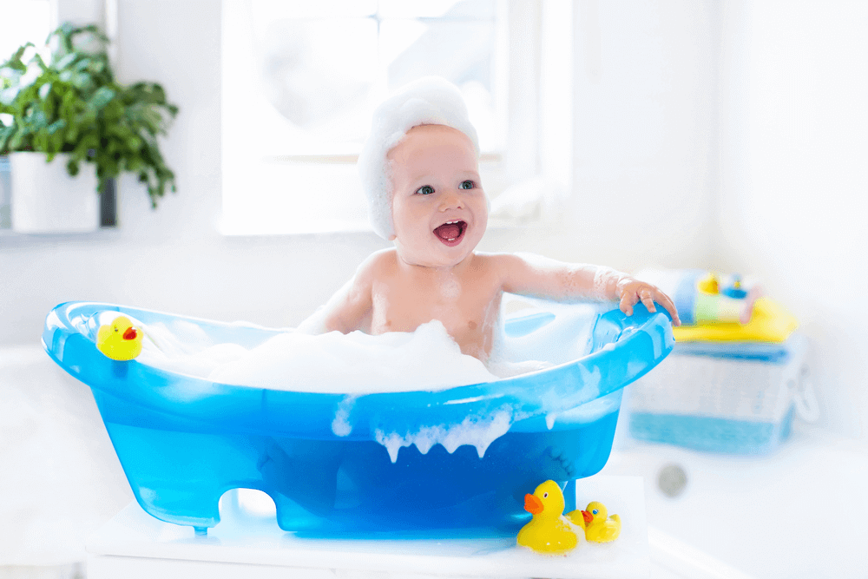
• The baby is smart. The baby is sensitive
• The baby is both smart and sensitive.

Slide 23


Slide 24
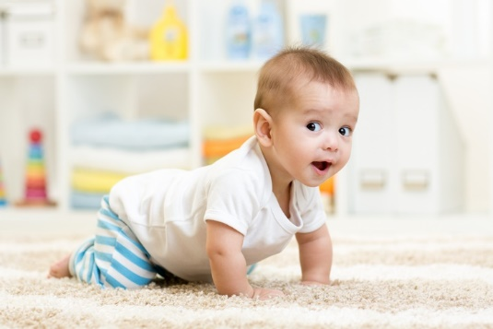
Check your answers.

Slide 25
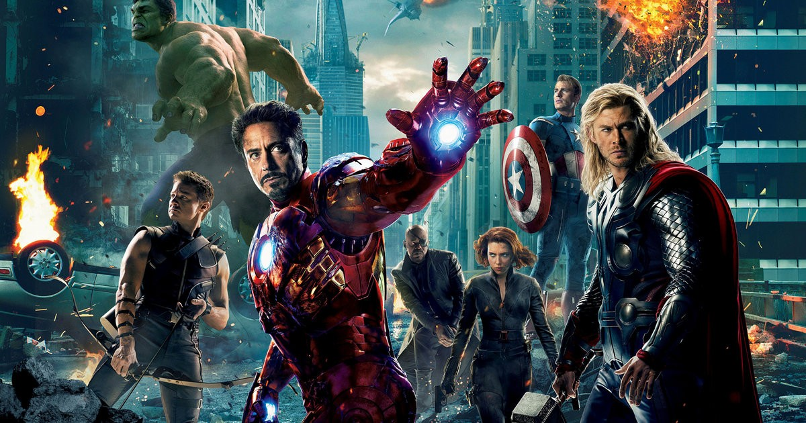
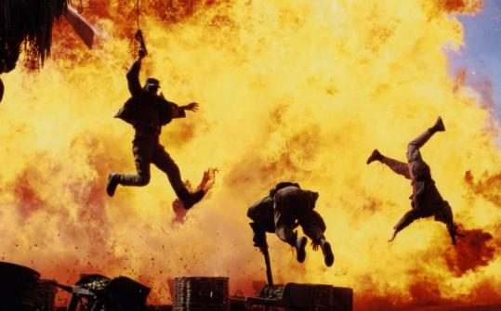
• Famous actors/talented/skillful
Famous actors are both talented and skillful.

Slide 26
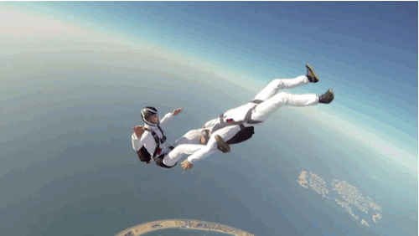
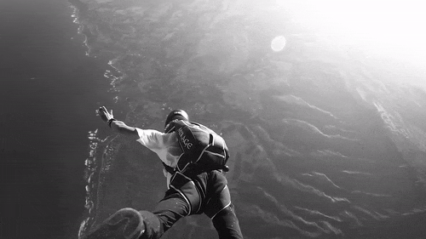
• Sky diving/interesting/dangerous.
Sky diving is both interesting and dangerous.

Slide 27
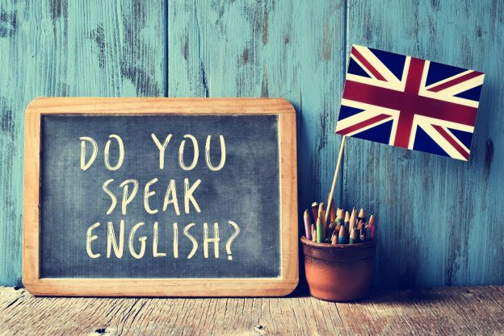
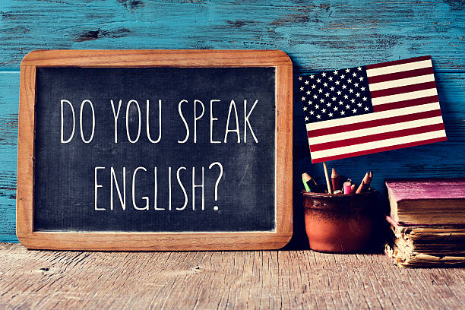
. • British people/American people/English
Both British and American people speak English.

Slide 29
Read your answers.

Slide 30
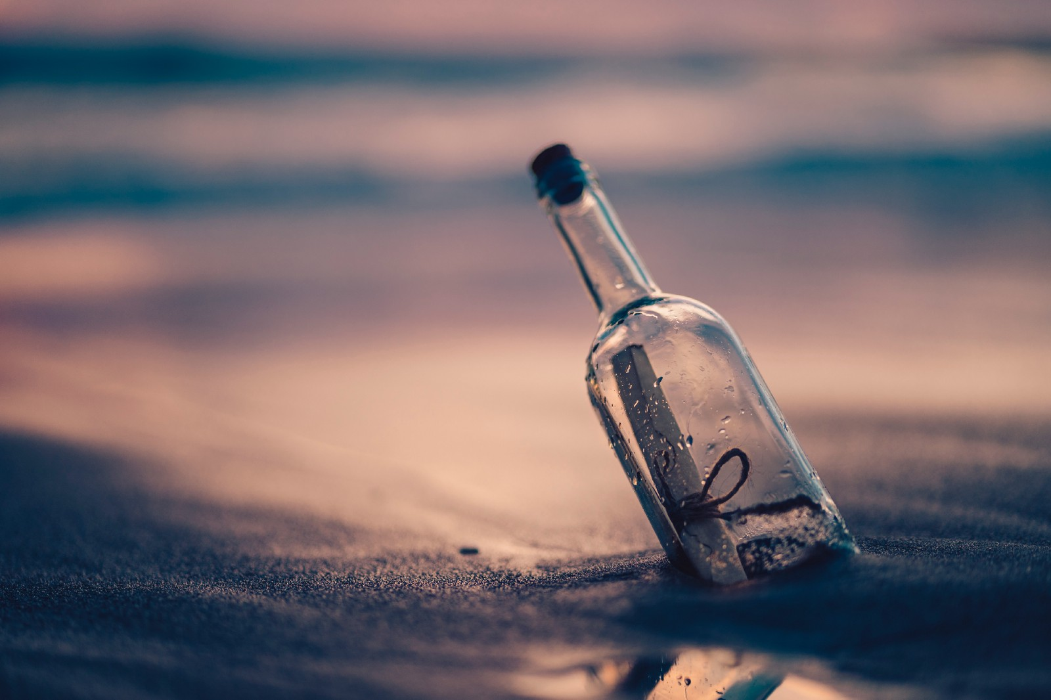

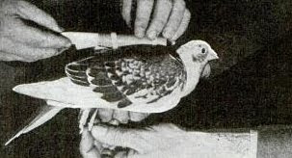
Both pigeons and bottles were used to send messages.

Slide 31
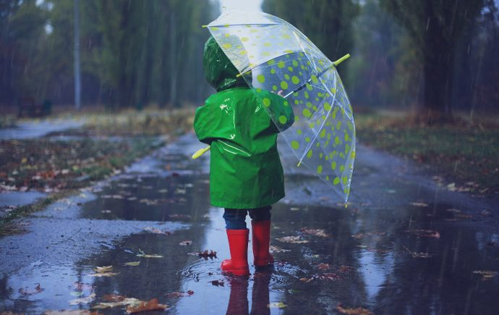

The weather is both rainy and cold.

Slide 32


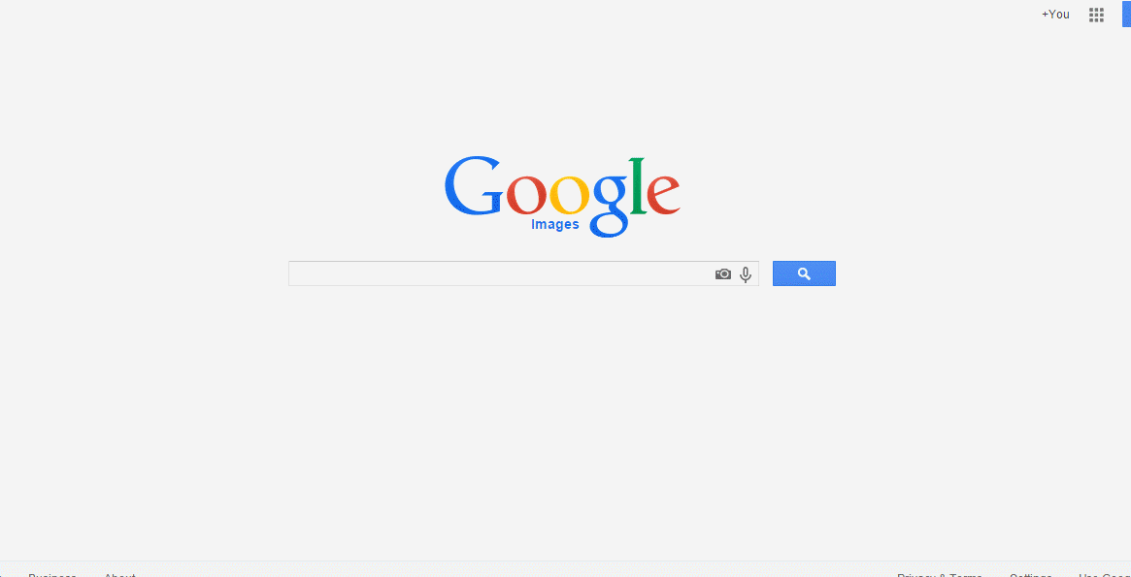
Both google and books can help us get
a lot of information.

Slide 33
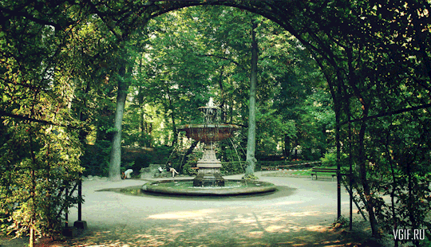

The park is both clean and quiet.

Slide 34
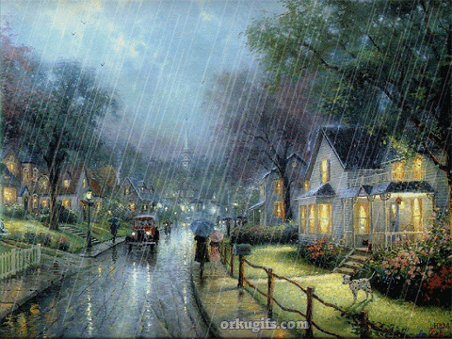
Workbook
Page 25

Slide 35


Slide 36


Read your answers.

Slide 37

a. Write words related to the meanings of the following words.
convey
exchange
reaction
means
talented
messages
opinions
strong
transport
student
news
ideas
direct
education
artist
ideas
knowledge
positive
communication
writer

Slide 38
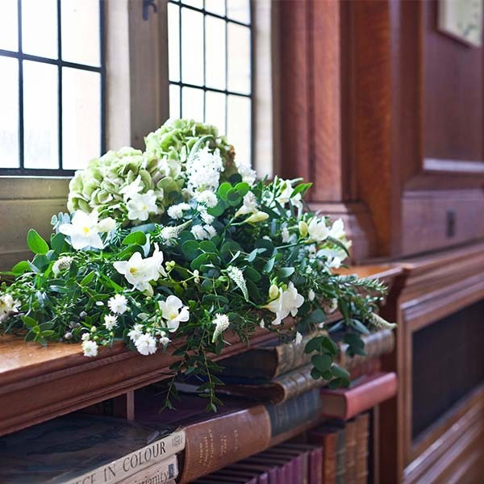
Closure!

Slide 39


Slide 40
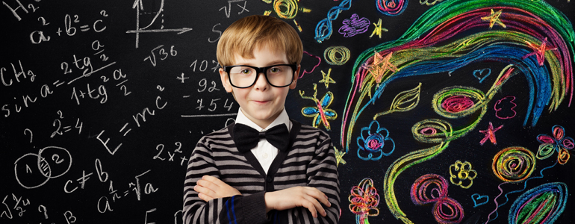

Read your answers.

Slide 41
exchange
People communicate to exchange ideas.
means
Cars and planes are means of transport.
talented
Artists are so talented.

Slide 42

Thank you

